Slide 1
GSU Poster Day Judging App
Group: Lolade Kasumu, David Jones, Carlos Guerrero, Razat Sutradhar

Slide 2
DEMO
Git: CSC4350-MW1/PosterJudging: Team10 (github.com)
Demo

Slide 3

Use Case
Start Time Window
Monitor Submissions
Database
Stop Time Window
Admin
Receives email of scores and winners

Slide 4
Use Case
Select Poster Form
Database
Input grades into rubric
User
Wait for results from admin

Slide 5
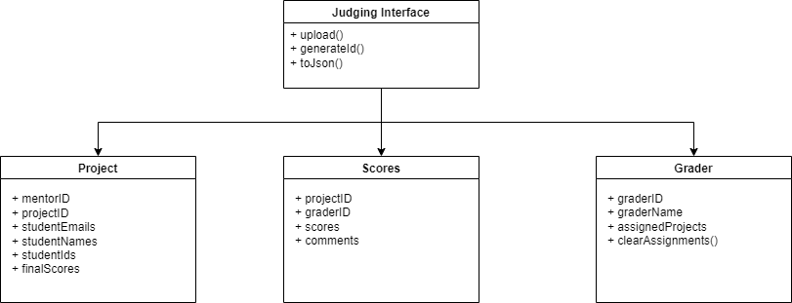
scoreAllProjects()
clearAllGradingAssignments()

Slide 6
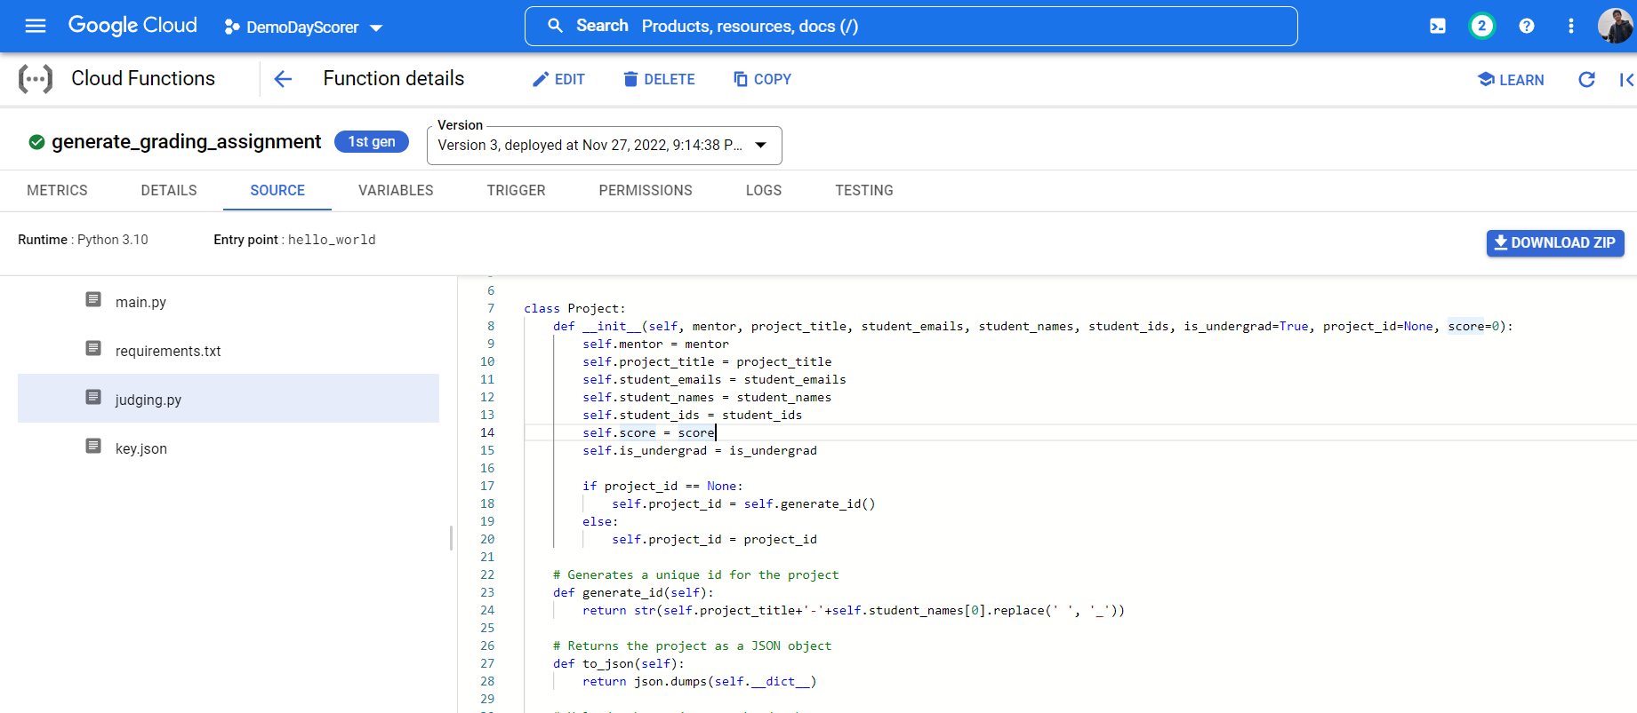
Trigger: HTTP GET trigger URL

Slide 7
Functional Requirements
Users (Judges) of the app should be able to input scores into a predefined rubric.
Admins should be able to allow submissions of posters and start/stop the voting period.
The app needs to have a timer to show when the voting period ends.
Once the calculations are done, the winners and scores must be sent to the admin.
The final, tabulated results must be sent out quickly to the admins

Slide 8
Non-Functional Requirements
The program must be completely operational on both desktop and on phones
The graders must have access to the slides that they have been assigned to grade
The program is easy for the judges to understand and to utilize
The data must be stored on databases using firestore
The program will eventually be integrated with GSU’s accounts to distinguish staff from students

Slide 9
Summary of Team Experience
The goal of our project is to implement a judging app for Georgia State University’s poster day. This app will eliminate the use of paper rubrics and manual scoring allowing judges to grade posters from an app.
Goals:
Eliminate manual grading and scoring
Allow judges to make submissions
Calculate the scores and display the winner
While working on this project we broke up the work into increments and had deadlines for each different component of the app. This worked well for us because it allowed us to finish the project in a timely manner and left us room for any problems we encountered.
Achievements:
We were able to get the functionality of the app to work
Allowing the admin to start and stop the time
Judge submission
User and admin sign in
Learning to implement new tools in an application

